Slide 1
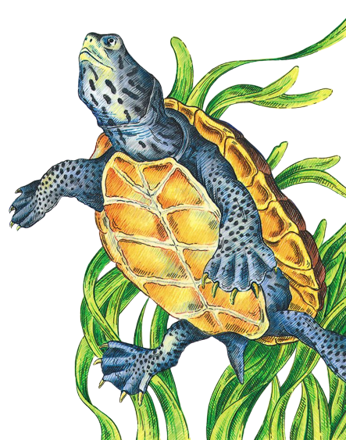
Terrapin
Tracker

Slide 2
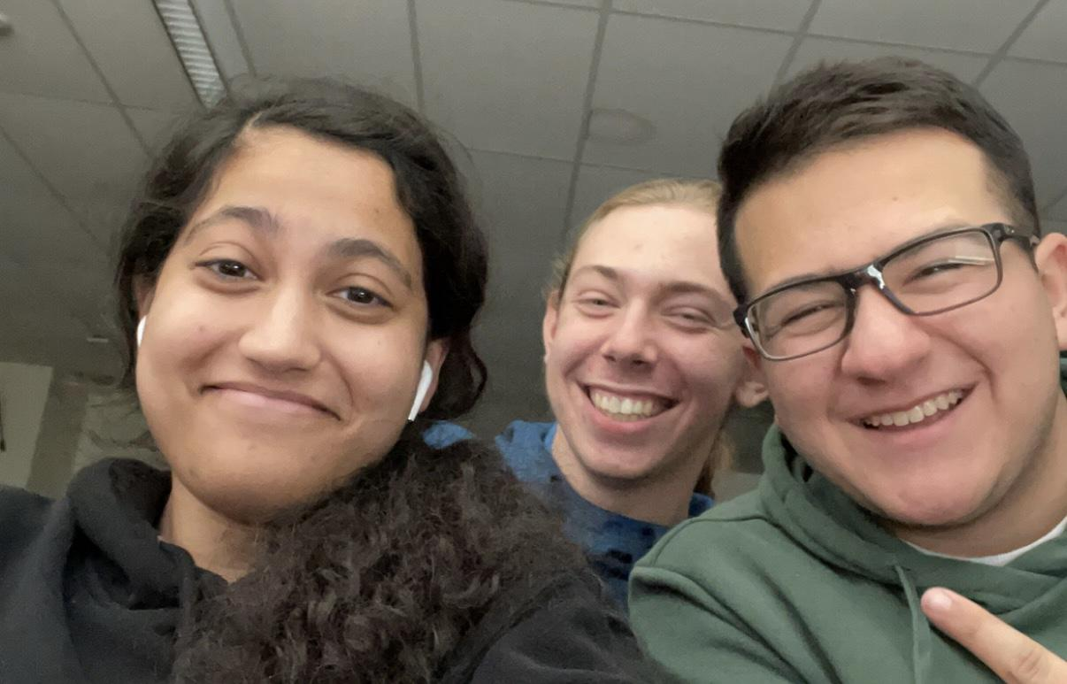
Creators
Lisa Hunt
MATES C/O 2023
Aidan Henbest
MATES C/O 2023
Angelo Amato
MATES C/O 2023

Slide 3
The Project Terrapin Club

Slide 4
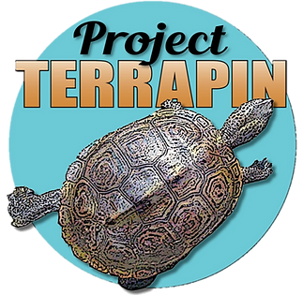
Project Terrapin
Helps growth of terrapins
Conservation, research, and education organization
Cares for mainly Northern Diamondback Terrapins
Largest club at MATES
Thousands of volunteer hours every year
20 years of research
6000+ volunteers statewide
Notes:
Supports projects throughout barnegat bay watershed

Slide 5
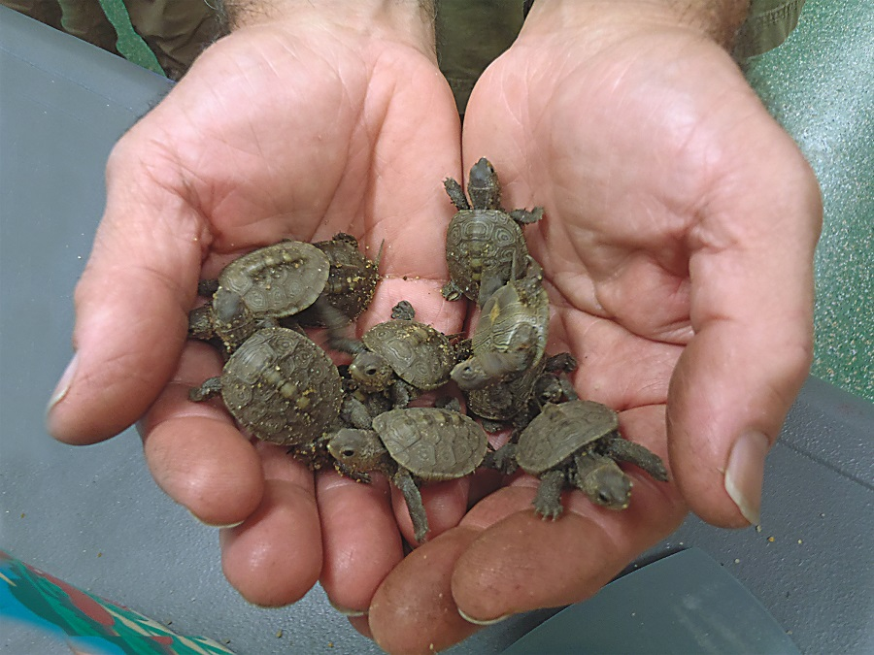
Hatchling Team
Collects eggs
Many in dangerous places
Cares for hatchling throughout the year
Releases hatchlings each June
Increases chance of survival
Years of data

Slide 6
The Problem

Slide 7
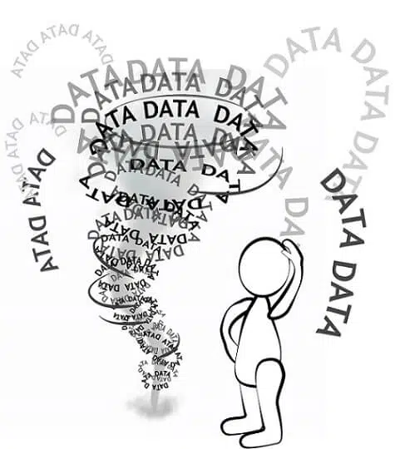
Current Data Organization
Measurements record on a collection of Google Sheets
Data is unorganized
No tracking of who took measurements
Old measurements get lost
Information can be accidentally deleted

Slide 8
Our Product

Slide 9
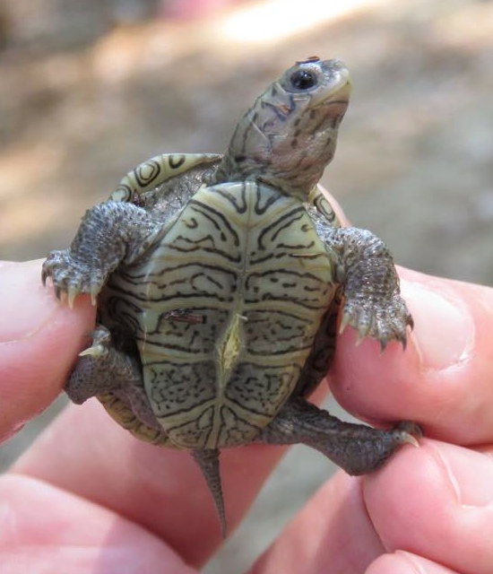
Project Overview
Introducing TerrapinTracker
Easily stores growth data
Current year
Past years
Tracks data by turtle
Regularly updating graphs
Logs member edits

Slide 10
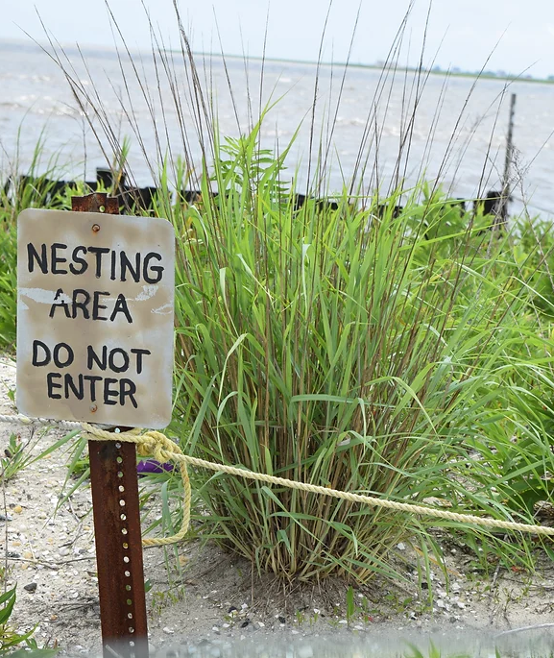
Why It Matters
Raise awareness
Keystone species
Ecosystem survival
Terrapin protection efforts
MATES involvement
Inspire others
Create personal connections with terrapins

Slide 11
Project Timeline
01 | 02 | 03
Organize Data | Design Website | Interactive Graphs
04 | 05 | 06
Member Accounts | Update New Data | Public Interface

Slide 12
Feedback?

